Slide 1
Unit-3 Clocks and Flip Flops
Clock waveforms, TTL clock, RS Flip Flops, Gated flip-flops, Edge triggered RS Flip-Flops, Edge triggered D Flip-Flops, and Edge triggered JK Flip-Flops, JK master slave Flip Flops, various representations of Flip Flops.

Slide 2
Types of Digital Circuits
Digital logic circuits are often known as switching circuits, because in digital circuits the voltage levels are assumed to be switched from one value to another value instantaneously. These circuits are termed as logic circuits, as their operation obeys a definite set of logic rules.
Combinational logic circuit
Sequential digital logic circuits

Slide 3
Definition of Combinational & Sequential circuits
Combinational circuits are defined as the time independent circuits which do not depends upon previous inputs to generate any output are termed as combinational circuits. Sequential circuits are those which are dependent on clock cycles and depends on present as well as past inputs to generate any output.
Examples – Encoder, Decoder, Multiplexer, Demultiplexer
Sequential circuits are those which are dependent on clock cycles and depends on present as well as past inputs to generate any output.
Flip-flops, Counters

Slide 4
Characteristics of Combinational logic circuits
In this output depends only upon present input.
Speed is fast.
It is designed easy.
There is no feedback between input and output.
This is time independent.
Elementary building blocks: Logic gates
Used for arithmetic as well as boolean operations.
Combinational circuits don’t have capability to store any state.
As combinational circuits don’t have clock, they don’t require triggering.
These circuits do not have any memory element.
It is easy to use and handle.

Slide 5
Characteristics of Sequentialal logic circuits
In this output depends upon present as well as past input.
Speed is slow.
It is designed tough as compared to combinational circuits.
There exists a feedback path between input and output.
This is time dependent.
Elementary building blocks: Flip-flops
Mainly used for storing data.
Sequential circuits have capability to store any state or to retain earlier state.
As sequential circuits are clock dependent they need triggering.
These circuits have memory element.
It is not easy to use and handle.

Slide 6
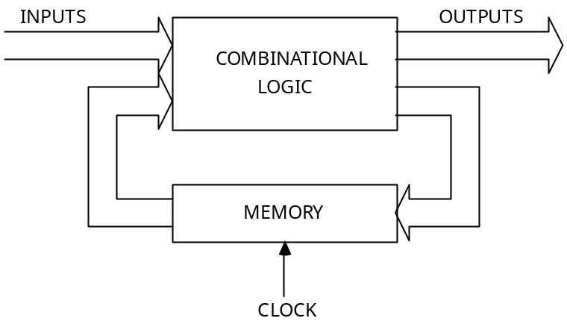
Sequential Logic Circuits
Any sequential logic system can be broken down into two sections:
Memory part
combinational part
The combinational part will comprise the usual AND, OR gates etc.
The memory part is usually implemented with bistable devices.
Two basic types: latches and flip-flops.

Slide 7
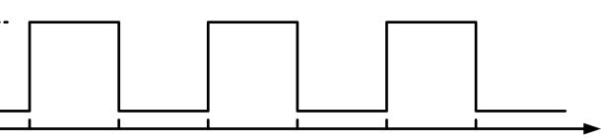
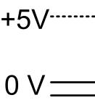
Clock Waveforms
The heart of every digital system is the system clock. The digital system signals are not static digital logic The clock signal advances the sys tem logic through sequence of steps.
Ideal Clock Waveform
The ideal clock waveform is as shown below:

Slide 8
Synchronous Operation
Most of the digital systems change states in synchronism with the system clock. A change of state will either occur as the clock makes a tr ansition from LOW to HIGH or as it makes a transition from HIGH to LOW.
Positive Transition
The LOW-to-HIGH transition is called the positive transition (PT). The PT is given emphasis by drawing a small arrow on the rising edge of th e clock waveform as shown in figure.

Slide 9
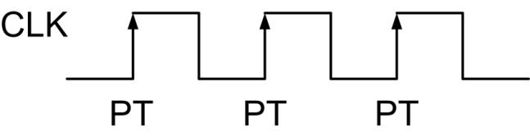
Positive Transitions
The LOW-to-HIGH transition is called the positive transition (PT). The PT is given emphasis by drawing a small arrow on the rising edge of the clock waveform as shown in figure below:
A circuit that changes state at this time is said to be positive-edge-triggered.

Slide 10
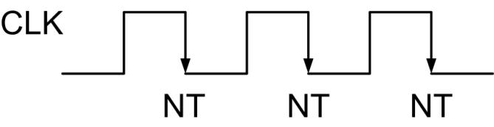
Negative Transition
The HIGH-to-LOW transition is called the negative transition (NT). The NT is given emphasis by drawing a small arrow on the falling edge of the clock waveform as shown in figure below:
A circuit that changes state at this time is said to be negative-edge-triggered.
Example: What is the clock cycle time for a system that uses a 1 MHz clock?
Solution: The clock cycle time T = 1/f
1/(1x10⁶) = 1x10⁻⁶ sec
1 μs

Slide 11
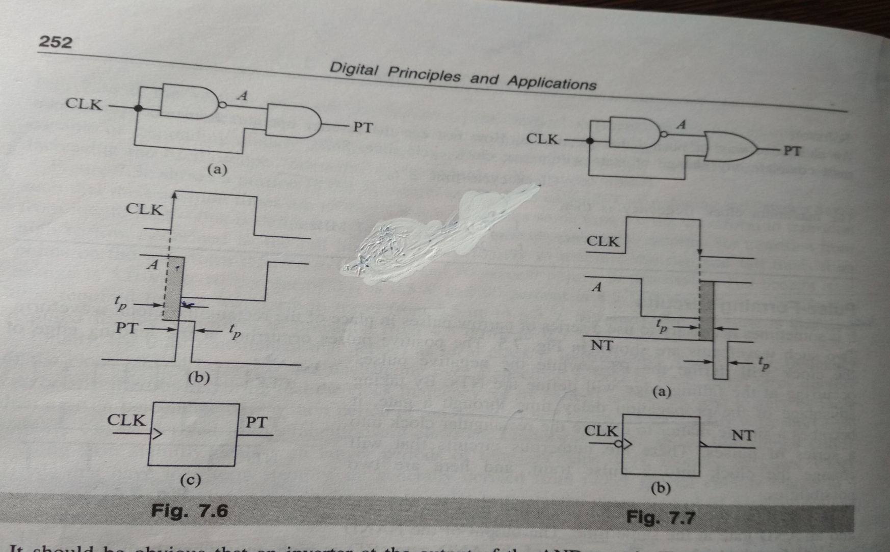
Pulse Forming Circuits

Slide 12
Characteristics of an Ideal Clock
Clock levels must be absolutely stable. When the clock is HIGH, the level must hold a steady value of +5 V. When the clock is LOW, the level must be an unchanging 0 V.
Clock should have zero transition time. The frequency of the clock should be steady and unchanging over a specified period of time.
Propagation Delay Time : Propagation delay t_{p} is the time between a positive transition (PT) / negative transition (NT) at the input of a digital circuit and the resulting change at the output. As shown in figures below, t_{pHL} is the delay time when the output is making a transition from HIGH to LOW. t_{pLH} is the delay time when the output is making a transition from LOW to HIGH. Usually t_{pHL} > t_{pLH} . We can assume t_{p} = t_{pHL} = t_{pLH} or t_{p} = (t_{pHL} + t_{pLH}) / 2.

Slide 13
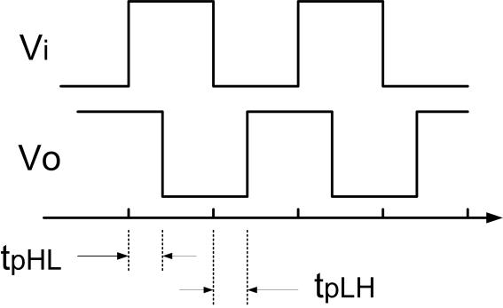
Ideal waveforms:

Slide 14
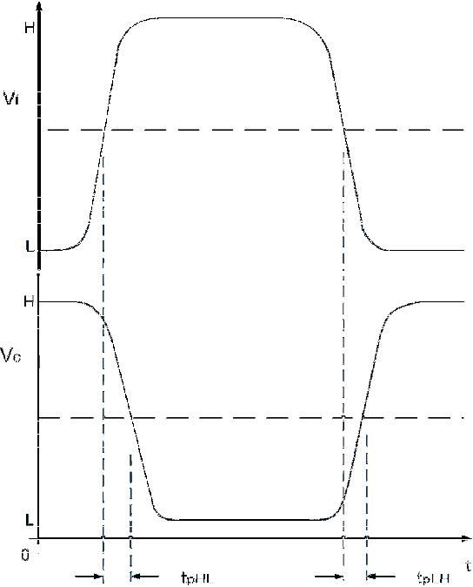
Practical waveforms:
For all practical purposes, the time difference between 50% level of the input and corresponding output waveforms is used to calculate propagation delay.

Slide 15
Latches
A latch changes state when the input states change. This property is known as transparency. Data is stored by the latch when an enable input (if provided) is valid.
A flip-flop however can only change state on the application of a clock pulse.
A purely sequential system is one in which the output is determined by the order in which the input signals are applied.
Sequential circuits are classified as asynchronous (unclocked) or synchronous (clocked).

Slide 16
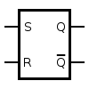
The Basic Latch
The basic latch has two stable states that correspond to a logic 1 and logic 0. The output changes from one state to another depending on the inputs.
Consider the simple latch shown below.
An SR latch (Set/Reset) is an asynchronous device: it works independently of control signals and relies only on the state of the S and R inputs. In the image we can see that an SR latch can be created with two NOR gates that have a cross-feedback loop. SR latches can also be made from NAND gates, but the inputs are swapped and negated. In this case, it is sometimes called an SR latch.
Truth table as shown below:

Slide 17
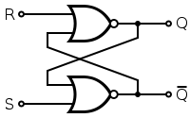
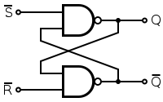
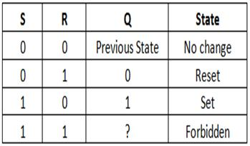
An SR latch made from two NOR and two NAND gates.

Slide 18
Continued…
When a high is applied to the Set line of an SR latch, the Q output goes high (and Q low). The feedback mechanism, however, means that the Q output will remain high, even when the S input goes low again. This is how the latch serves as a memory device. Conversely, a high input on the Reset line will drive the Q output low (and Q high), effectively resetting the latch's "memory". When both inputs are low, the latch "latches" – it remains in its previously set or reset state.
When both inputs are high at once, however, there is a problem: it is being told to simultaneously produce a high Q and a low Q. This produces a "race condition" within the circuit - whichever flip flop succeeds in changing first will feedback to the other and assert itself. Ideally, both gates are identical and this is "metastable", and the device will be in an undefined state for an indefinite period. In real life, due to manufacturing methods, one gate will always win, but it's impossible to tell which it will be for a particular device from an assembly line. The state of S = R = 1 is therefore "illegal" and should never be entered.

Slide 19
Flip-Flops(1 bit memory)
Sequential logic is a form of binary circuit design that employs one or more inputs and one or more outputs, whose states are related by defined rules that depend, in part, on previous states. Each of the inputs and output(s) can attain either of two states: logic 0 (low) or logic 1 (high).
A common example of a circuit employing sequential logic is the flip-flop, also called a bistable gate. A simple flip-flop has two stable states. The flip-flop maintains its states indefinitely until an input pulse called a trigger is received. If a trigger is received, the flip-flop outputs change their states according to defined rules, and remain in those states until another trigger is received.
Flip-flops, also called bistable gates, are digital logic circuits that can be in one of two states. Flip-flops maintain their state indefinitely until an input pulse called a trigger is received. When a trigger is received, the flip-flop outputs change state according to defined rules and remain in those states until another trigger is received. Flip-flop circuits are interconnected to form the logic gates for the digital integrated circuits (IC s) used in memory chips and microprocessors. Flip-flops can be used to store one bit, or binary digit, of data. The data may represent the state of a sequencer, the value of a counter, an ASCII character in a computer's memory or any other piece of information.

Slide 20
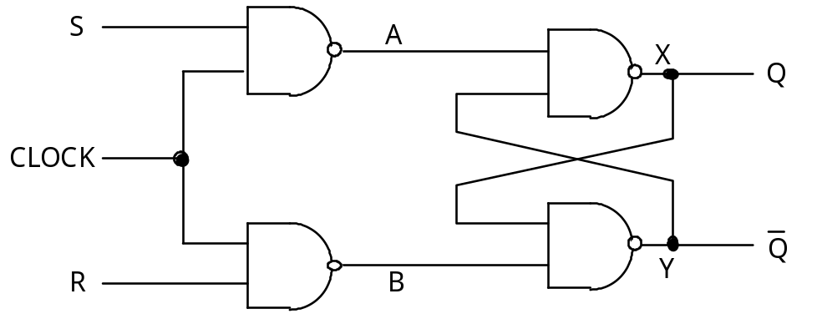
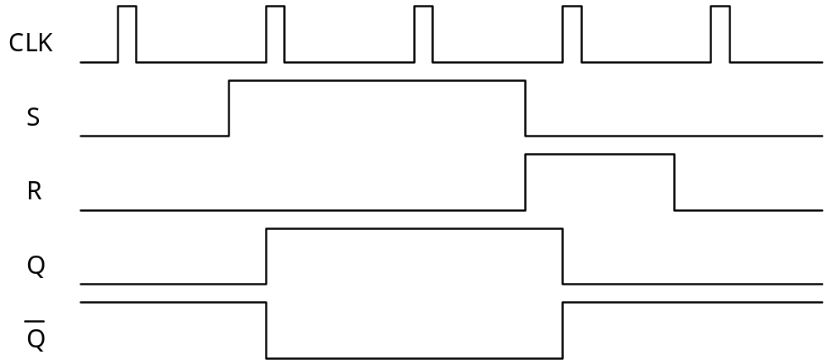
The Gated SR Latch
The Gated SR Latch

Slide 21
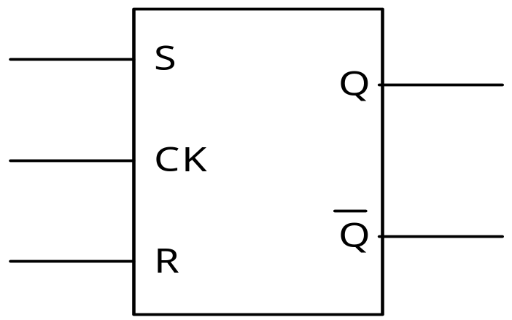
Symbol & Truth table
The truth table is now:
Truth table
Symbol
R | S | Clk | Q | /Q
X | X | 0 | X | X | Same as A = B = 1
0 | 0 | 1 | X | X | Same as A = B = 1
0 | 1 | 1 | 1 | 0
1 | 0 | 1 | 0 | 1
1 | 1 | 1 | 1 | 1
The function of the RS gated latch can be illustrated with a waveform diagram as shown below.

Slide 22
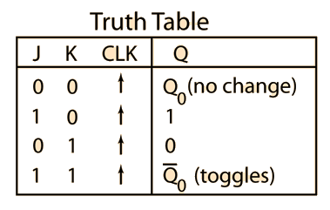
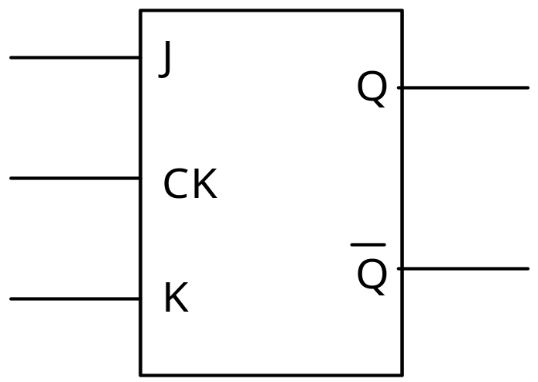
The JK Flip-Flop
The JK flip-flop is basically an SR gated latch with modifications to eliminate the problems of the final indeterminate state. When the two inputs J and K are both 1 then the output Q changes state. It is said to toggle under these conditions.
Circuit Symbol:

Slide 23
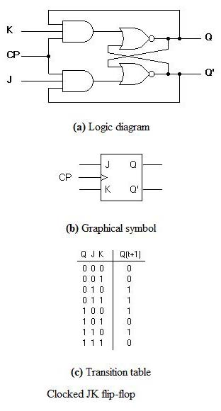
Clocked J-K Flip Flop

Slide 24
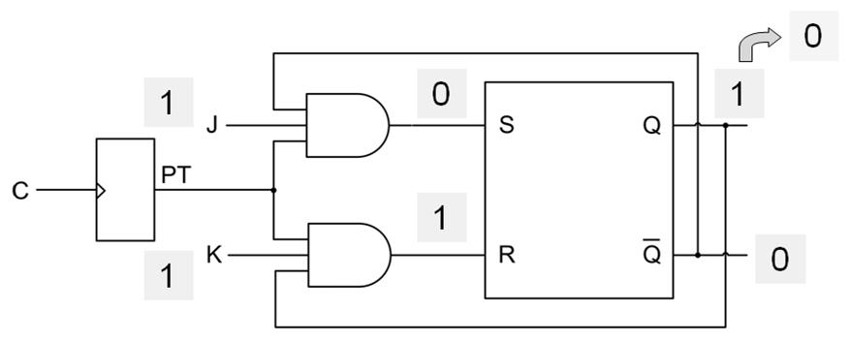
JK Flip-Flop Operation
Consider J = K = 1. If Q = 1, the lower AND gate passes a RESET pulse on the next PT and Q changes to 0 as illustrated in the figure below:

Slide 25
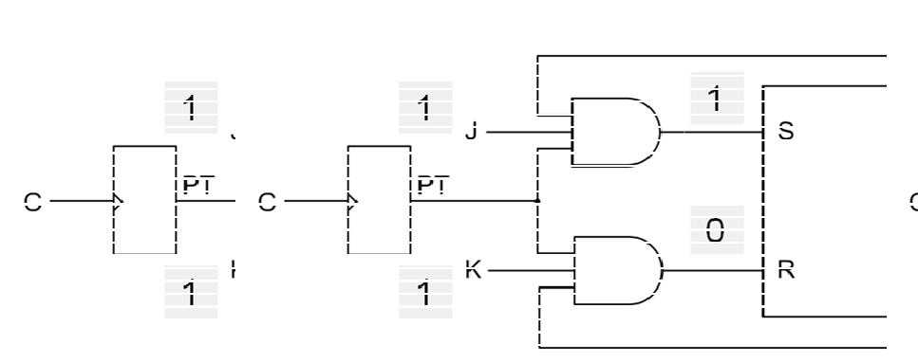
Consider J = K = 1. If Q = 0, the upper AND gate passes a SET pulse on the next PT and Q changes to 1 as illustrated in the figure below:
Therefore, J = K = 1 means the flip-flop will toggle (switch to the opposite state) on the next positive clock edge.

Slide 26
Racing Problem
When J = K = 1, the output can continue to toggle as long as the clock is high. This condition is called the race-around condition. Propagation delay prevents the JK flip-flop from racing. The JK flip-flop output changes after the PT of the clock. T he new Q and Q’ values are too late to coincide with the PTs driving the AND gate. If PTs are narrower than the propagation delay of the flip-flop, the returning Q and Q’ arrive too late to cause false triggering.
Avoiding Racing Problem
A better method to avoid race around condition is to use a master-slave circuit.

Slide 27
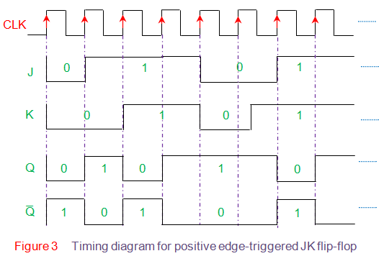
Timing Diagram

Slide 28
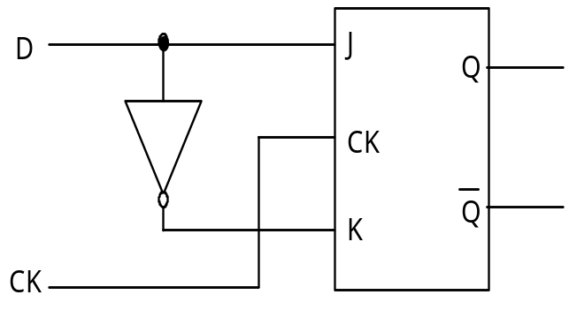
The D-Type Flip-Flop
The D (data) type flip-flop is basically a single-bit storage device. It can be constructed by connecting an inverter between the J and K inputs of a JK flip-flop as shown overleaf.
D | Qn+1
0 | 0
1 | 1

Slide 29
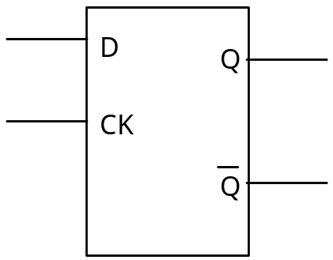
Data appearing on the data input D is simply clocked through to the output Q on the application of a clock pulse.
Symbol:

Slide 30
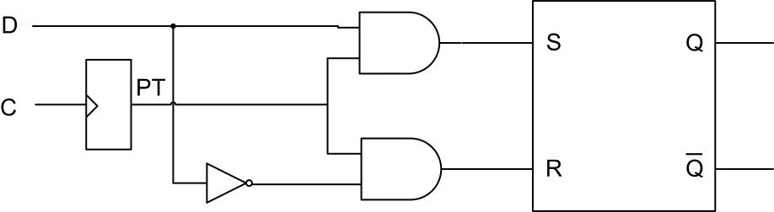
Edge-triggered D Flip-Flop
The logic circuit of a positive-edge triggered D flip-flop is as shown:
On the leading edge of the clock (P T), the data bit is loaded into the flip-flop and Q takes on the value of D. The truth table is as shown below:

Slide 31
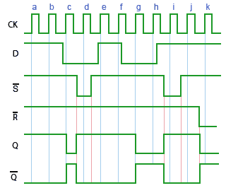
Timing Diagram of D flip flop

Slide 32
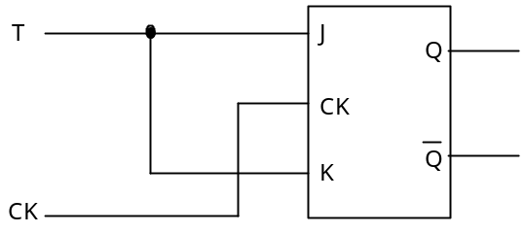
T-Type Flip-Flop
The T (toggle) type flip-flop also has a single input. It too can be implemented using a JK flip-flop; the inputs are simply connected together as shown below
T | Qn+1
0 | Qn
1 | /Qn

Slide 33
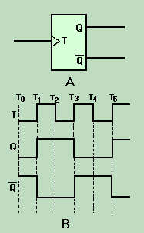
Timing Diagram of T flip flop

Slide 34
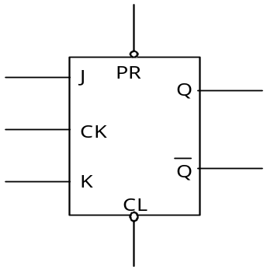
PR ESET and CLEAR inputs
When power is first applied, flip-flops will have their outputs in random states. We can make the flip-flop to have the desired starting state. Additional PRESET and CLEAR inputs are used. The PRESET and CLEAR inputs are called asynchronous inputs because they activate the flip-flop independently of the clock. The D input is a synchronous input because it has an effect only with the positive transitions of the clock.

Slide 36
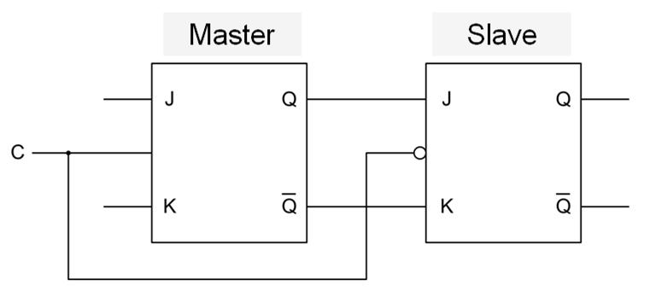
JK Master-Slave Flip-Flop
The JK master-slave flip-flop configuration is as shown below: The J and K data is processed by the flip-flop after a complete clock pulse. On the positive transition of the clock, the data from the J and K inputs is transferred to the master. On the negative transition of the clock, the data from the master is transferred to the slave. The flip-flop is referred to as pulse-triggered.

Slide 37
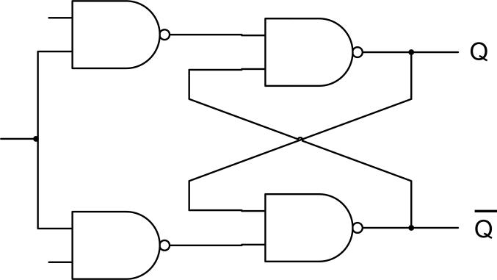
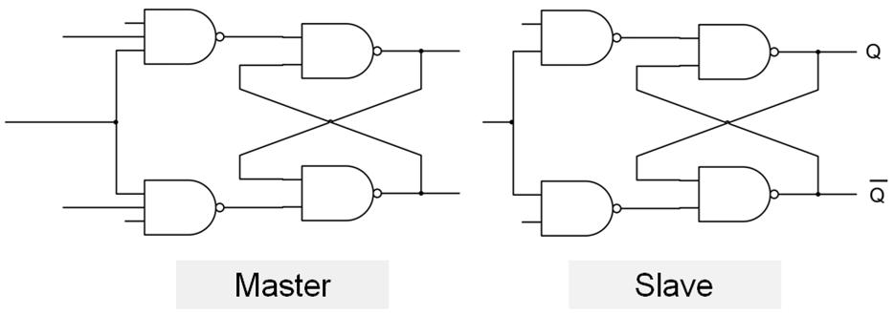
JK Master-Slave Flip-Flop Construction using NAND gates
Step 1 :
Step 2

Slide 38
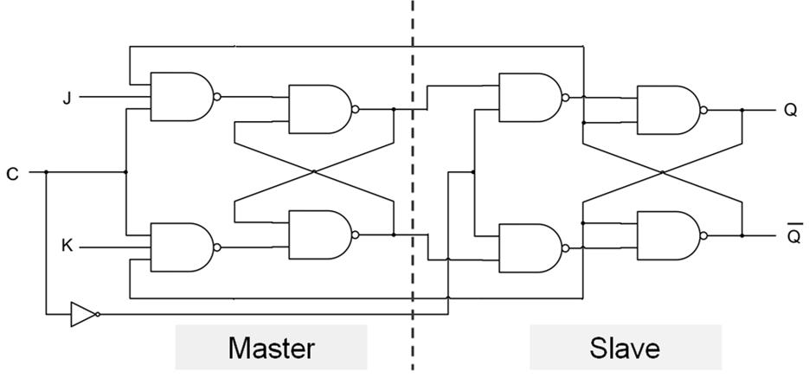
Continued…

Slide 39
Various Representations of Flip-Flops
There are various ways a flip-flop c an be represented, each one suitable for certain application. They are:
Truth Tables or Characteristic Tables
Characteristic Equations
Finite State Machine
Excitation Table

Slide 40
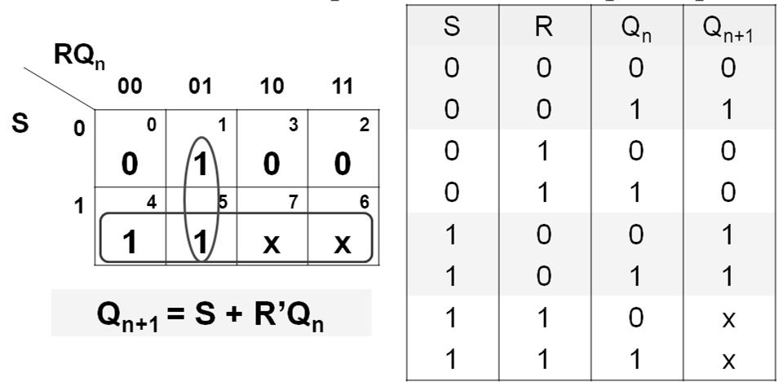
Characteristic Equations
The characteristic equations of flip-flops are useful in analyzing circuits made of hem. Here, next output Q_{n+1} is expressed as a function of present output Q_{n} and inputs to flip-flop.
Characteristic Equation of SR Flip-Flop
The characteristic equation of SR flip-flop is obtained as shown below:

Slide 41
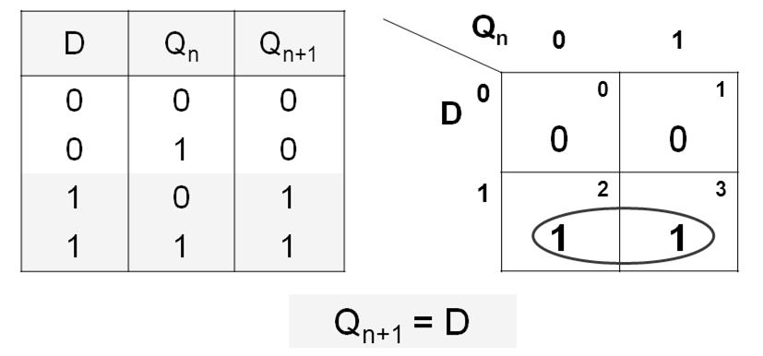
Characteristic Equation of D Flip-Flop
The characteristic equation of D flip -flop is obtained as shown below.

Slide 42
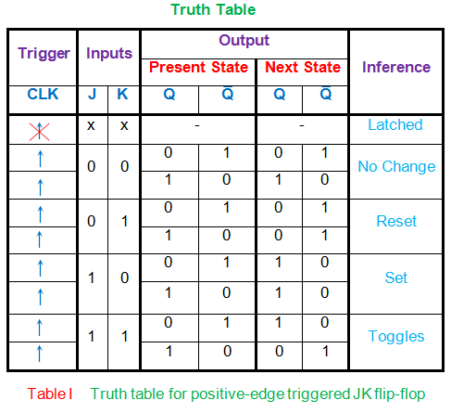

Slide 43
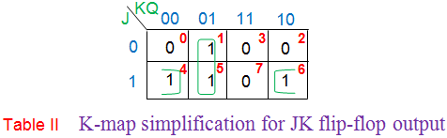
Characteristic Equation of JK Flip-Flop

Slide 44
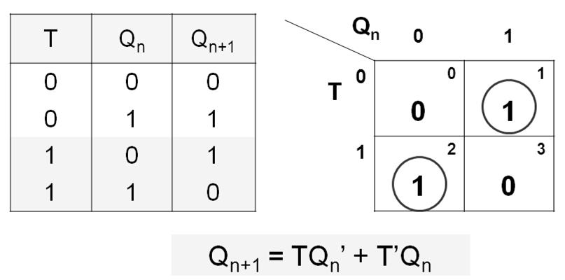
Characteristic Equation of T Flip-Flop
The characteristic equation of T flip -flop is obtained as shown below:
Drawback of Truth Table
For a complex circuit a truth table is difficult to read as its size becomes too large. In finite state machine (FSM), functional behavior of the circuit is explained using finite number of states.

Slide 45
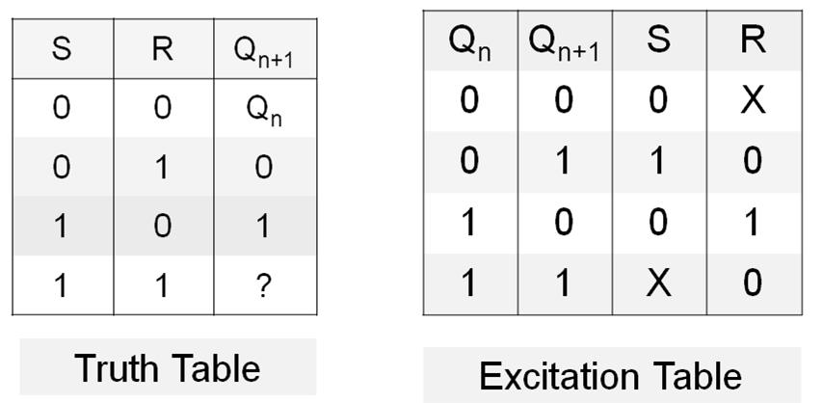
Flip-Flop Excitation Table
Truth tables are important in analysis problems. Excitation tables show the required input trigger signals required for the desired flip-flop state transition. Excitation tables are very useful in synthesis or design problems. The excitation tables of different flip-flops are as shown:
Excitation Table of SR flip-flop

Slide 46
Excitation Table of SR flip-flop

Slide 47
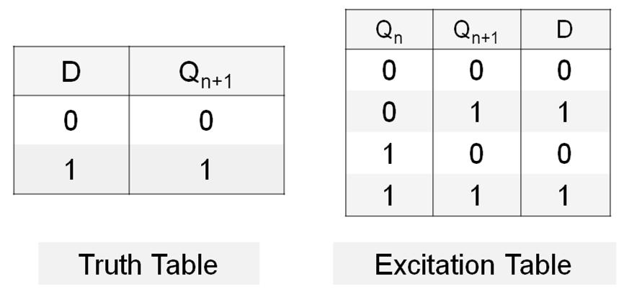
Excitation Table of D flip-flop

Slide 48
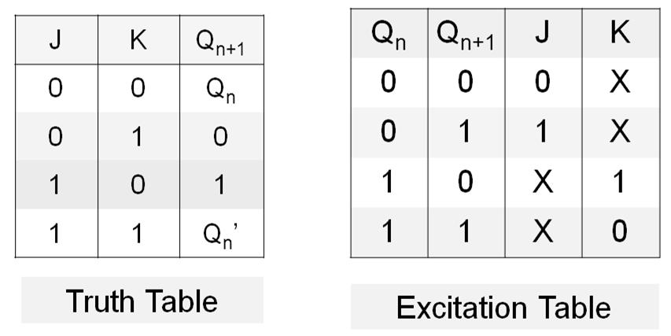
Excitation Table of JK flip-flop

Slide 49
Excitation Table of T flip-flop
States |  | Input
Present Qn | Next Qn+1 | T
0 | 0 | 0
0 | 1 | 1
1 | 0 | 1
1 | 1 | 0
Q(t) | Q(t+1) | T
0 | 0 | 0
0 | 1 | 1
1 | 0 | 1
1 | 1 | 0

Slide 50
Flip Flops as Finite State Machine
It is a computation model that can be implemented with hardware or software and can be used to simulate sequential logic and some computer programs.
Sequential circuits change their states for every positive or negative transition of the clock signal based on the input. So, this behavior of synchronous sequential circuits can be represented in the graphical form and it is known as state diagram.

Slide 51
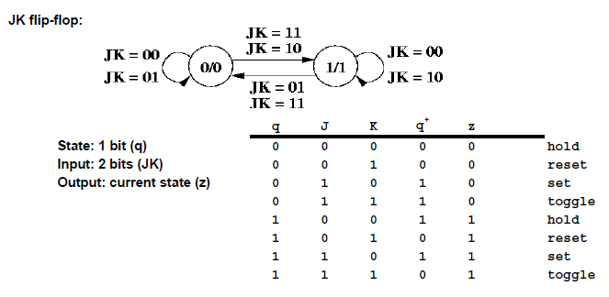
State Transition Diagram of JK flip flop

Slide 52
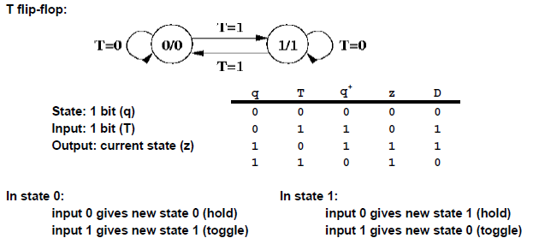
State Transition Diagram of T flip flop

Slide 53
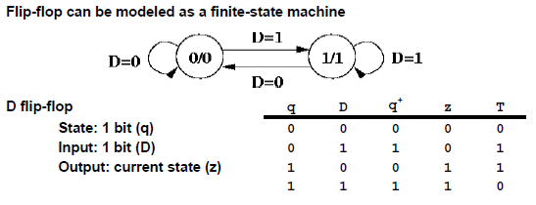
State Transition Diagram of JK flip flop

Slide 54
Can You Draw For SR flip flop?

Slide 55
